Slide 1
OSPF
OPEN SHORTEST PATH FIRST

Slide 2
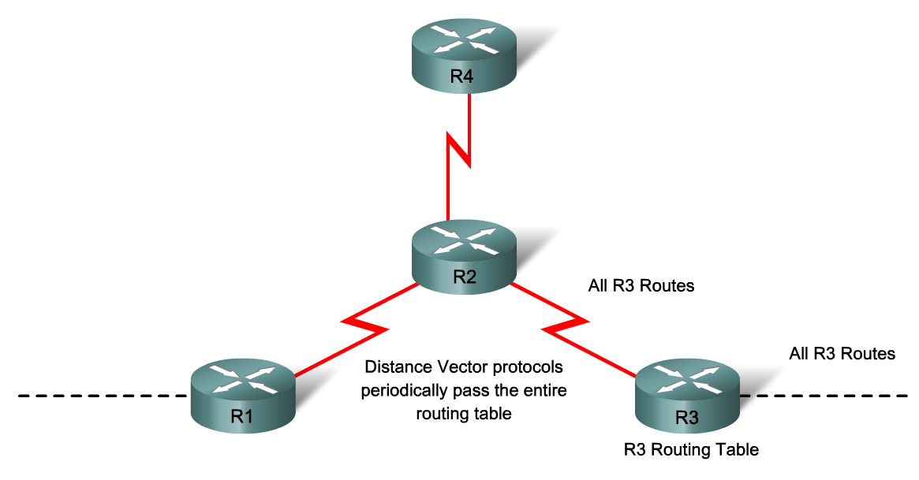
INTRODUCTION (1/2)
Link-state routing protocol
Open standard developed by IETF
Classless interior gateway protocol
Divides the network into areas for scalability

Slide 3
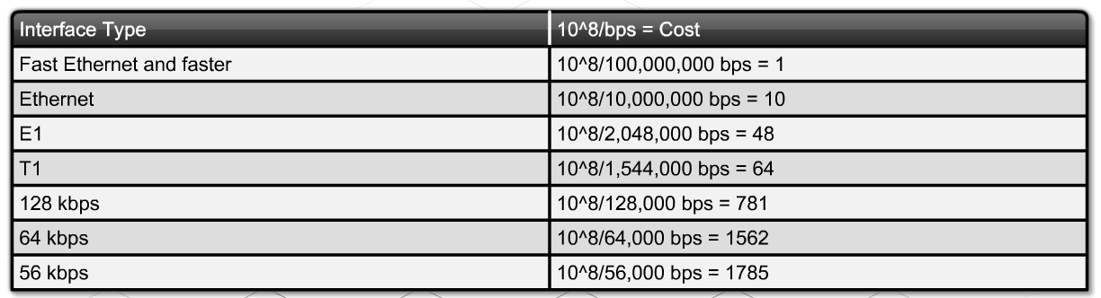
INTRODUCTION (2/2)
Bandwidth determines the cost of a link
Higher bandwidth = lower cost = desirable route
Cost = 100,000,000 / bandwidth of link in bps
Manual cost configuration at an interface: ip ospf cost

Slide 4
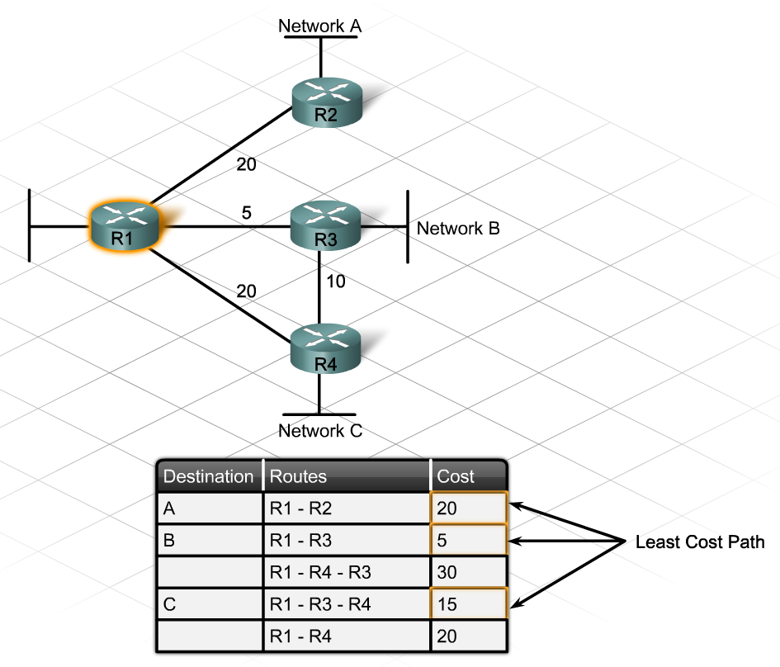
DESCRIBE AND PLAN A NETWORK USING OSPF
SPF algorithm (Diijkstra’s Algorithm)
Each router has a topological tree
SPF tree information stored in topology database

Slide 5
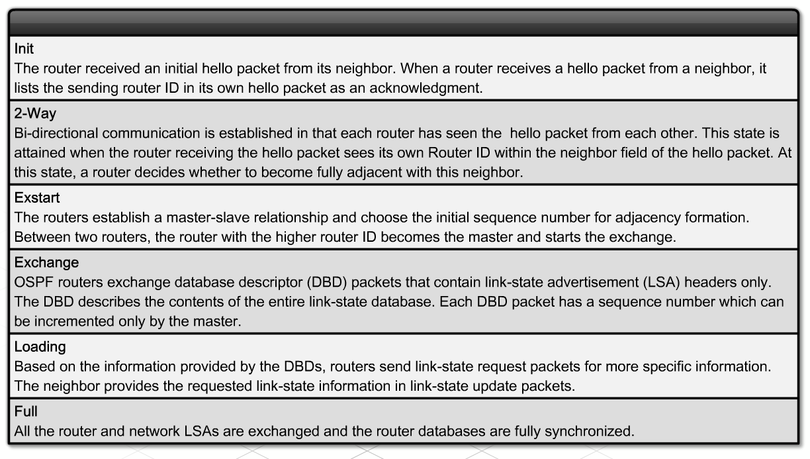
DESCRIBE AND PLAN A NETWORK USING OSPF
Adjacencies: neighbor relationships
Hello protocol
Router ID
Role of loopback interfaces

Slide 6
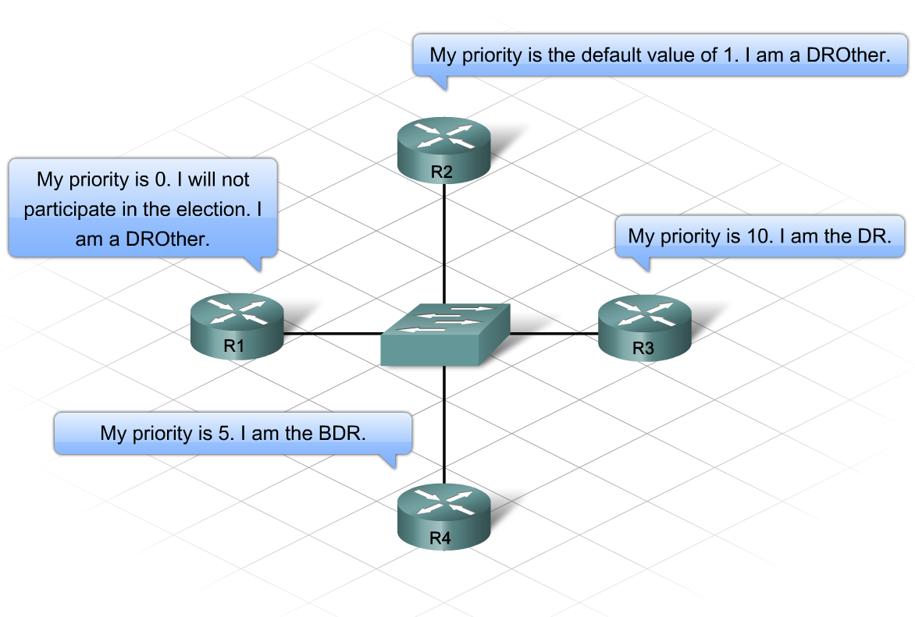
DESCRIBE AND PLAN A NETWORK USING OSPF
Designated router (DR)
Backup designated router (BDR)
DROther

Slide 7
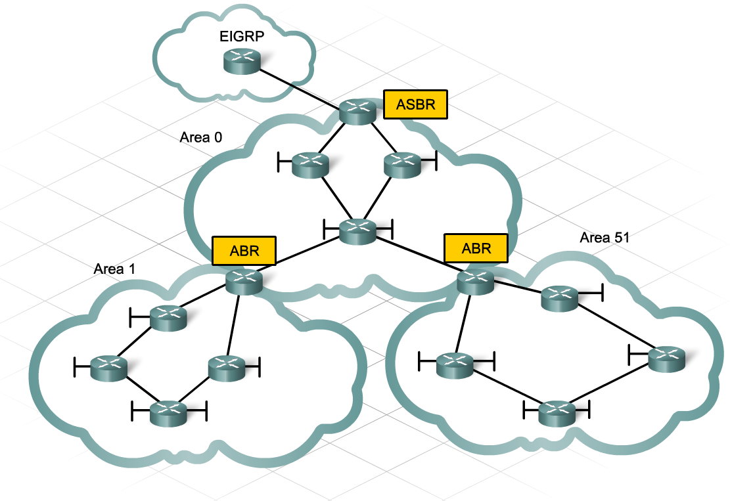
DESCRIBE AND PLAN A NETWORK USING OSPF
Area 0
Roles of routers in an OSPF Autonomous System:
  Area Border Router (ABR)
  Autonomous System Border Router (ASBR)

Slide 8
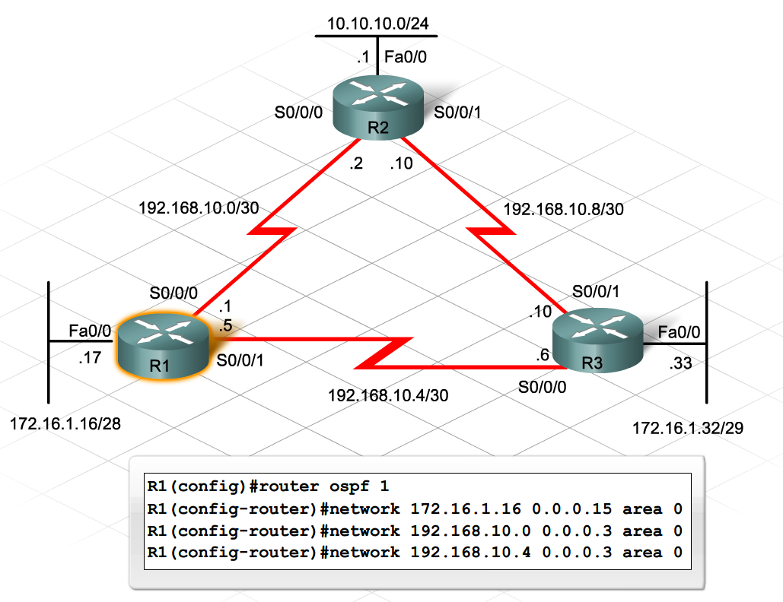
DESIGN AND CONFIGURE NETWORK USING SINGLE-AREA OSPF
OSPF configuration steps:
Enable OSPF + process ID
Advertise networks + wildcard mask and area ID

Slide 9
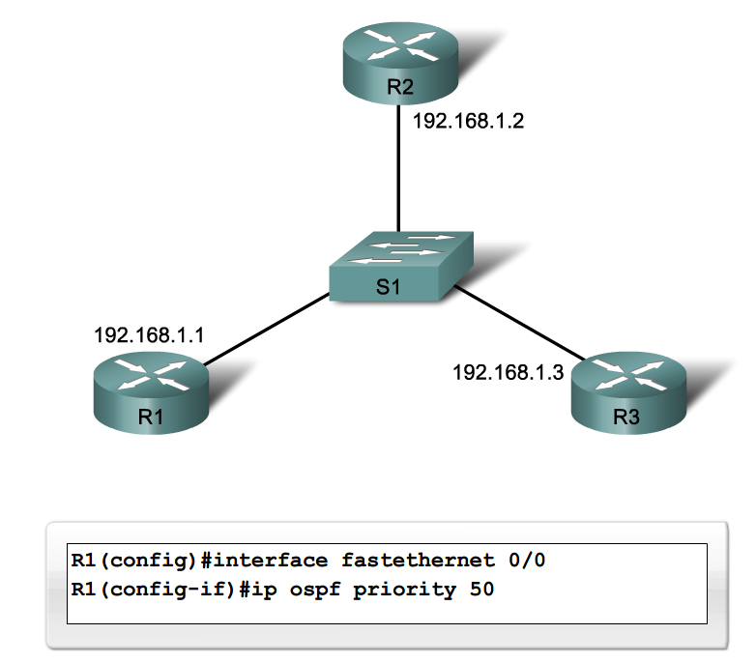
TUNE OSPF PARAMETERS
Interface priority
Router ID
Loopback and interface addresses
Bandwidth (cost )

Slide 10
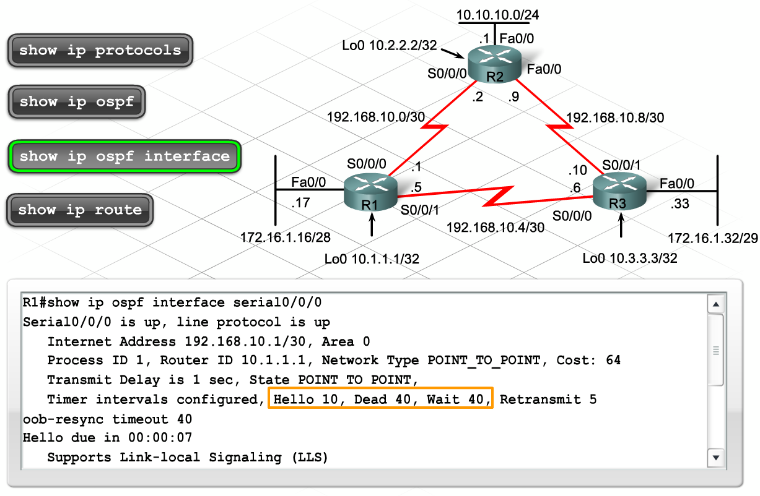
VERIFICATION AND TROUBLESHOOTING COMMANDS
show ip ospf neighbor
show ip protocols, show ip route
show ip ospf, show ip ospf interface

Slide 11
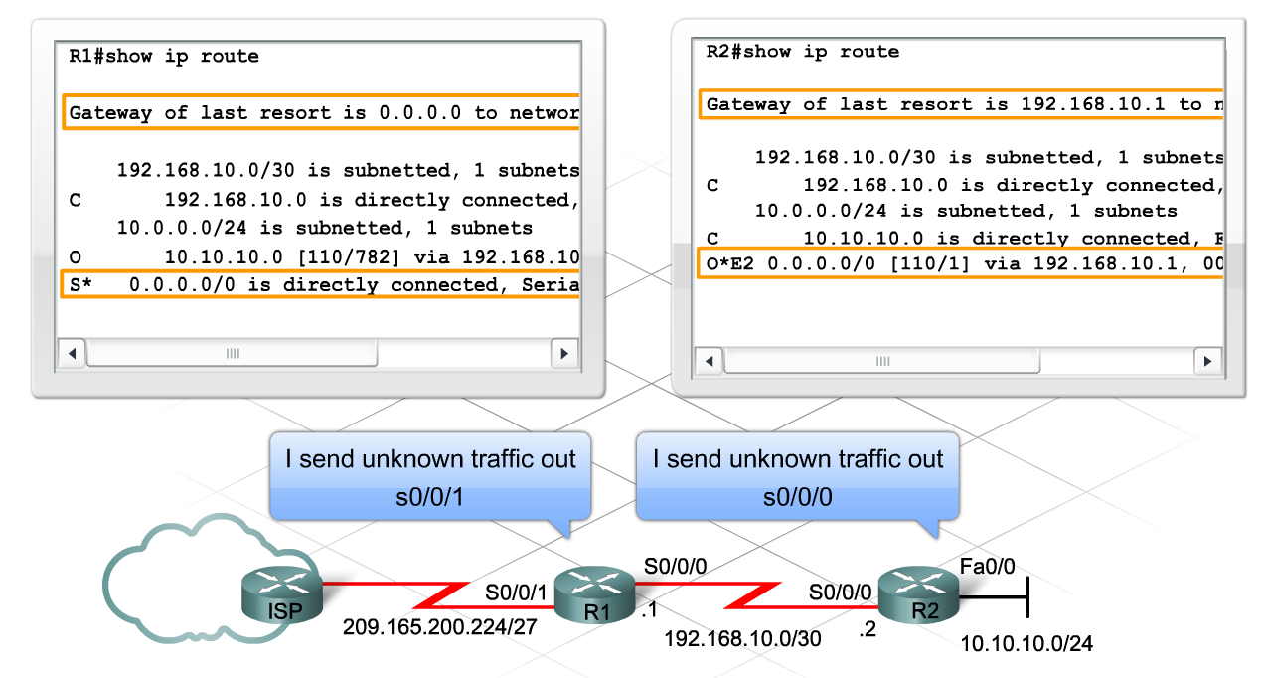
WORK WITH MULTI-PROTOCOL ENVIRONMENTS
Default route configured on ASBR
ASBR distributes the route into the OSPF network

Slide 12
SUMMARY
OSPF is a classless interior link-state routing protocol used in enterprise networks
OSPF uses bandwidth to generate the cost metric
OSPF routers elect a DR and BDR on multi-access networks
Router ID or router priority can be used to dictate the selection of DR and BDR
The OSPF network command uses a wildcard mask
Default route distribution and inter-area route summarization are used in OSPF networks

